Slide 1
Constructors and Destructors

Slide 2
Introduction
What is a constructor?
Constructor is a special member function that creates new object, and possibly assigns values to the data members (in this case, num and den)
In the previous example, when we did:
Fraction f;
The program will secretly create a basic constructor for you. It will be Fraction() in this case. We just put that into our member functions as well

Slide 3
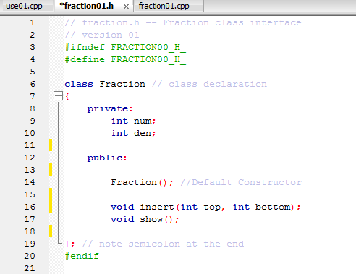

Slide 4
Cont’d
The question is, of course, if the program will secretly do it for you, why do you need to manually put it in the first place?
First, let’s go back to the basic:
We can certainly declare and initialize a variable, such as:
int x=10;
Shouldn’t we supposed to do this also for Fraction f? Something like:
Fraction f=(3, 6); so the variable f will have 3 as num and 6 as den?
Right now we can’t do that because the one constructor the program secretly put it for us, Fraction() has no parameter.

Slide 5
Cont’d
We need to modify our constructor, by putting the correct parameter and assign the values into num and den in member functions’ implementation:
Notice that we have no return type for constructor, so the implementation of the constructor in this case is Fraction::Fraction(int top, int bottom)
So in fraction01.h: (new version) (next slide)
And in fraction00.cpp: (two slides later)

Slide 6
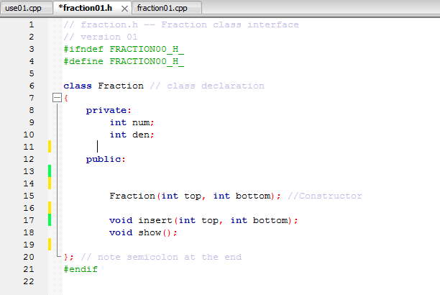

Slide 7
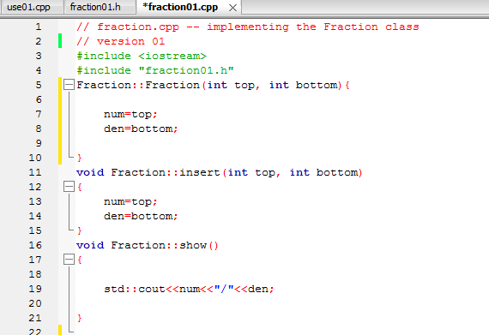

Slide 8
What’s next?
Now we can define and initialize
Fraction f=(3, 6); in user01.cpp
But we have another problem now!!
When the program sees that you have the constructor set up, the program will no longer provide the initial constructor to you
Which means Fraction f won’t work now, since we have no Fraction(); anymore

Slide 9
Way to go around it
Therefore we would need two constructors
One for Fraction f; (Fraction();)
One for Fraction f=(3, 6); (Fraction(int top, int bottom);)
So in the fraction01.cpp (The implementation) would be
Fraction::Fraction()
Fraction::Fraction(int top, int bottom)

Slide 10
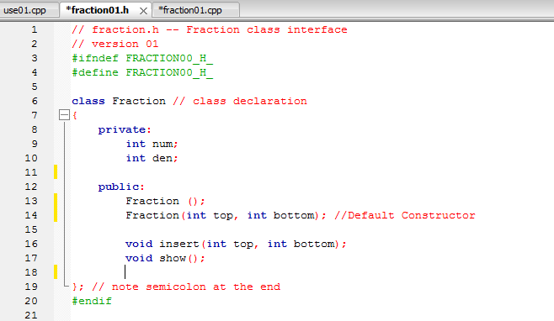

Slide 11
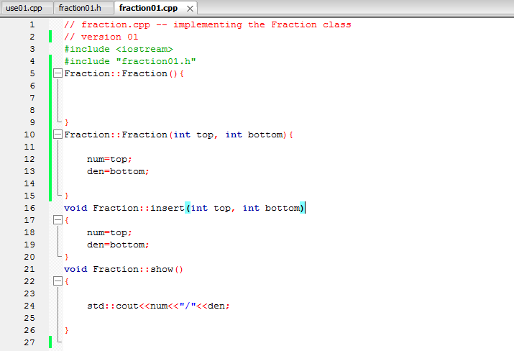

Slide 12
More
From the Constructor Fraction(); since it has nothing inside nothing has been initialized, data will have random value when you show them
We can even modify the Fraction() constructor to start with 0/1 all the time

Slide 13
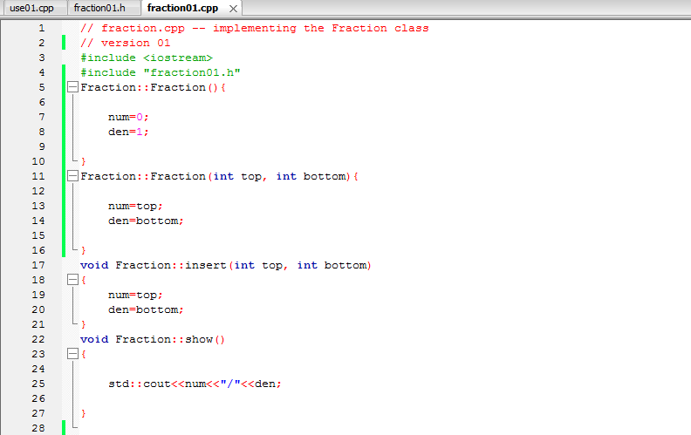

Slide 14
Destructor
A destructor is a special member function that is called when the lifetime of an object ends. The purpose of the destructor is to free the resources that the object may have acquired during its lifetime. (from http://en.cppreference.com/w/cpp/language/destructor)
Normally your program will not need to call a destructor, the compiler will handle that
The destructor must have no argument inside (~Fraction();)
In the function of destructor, however, we could write own content
It’s very similar to how constructor was being created

Slide 15
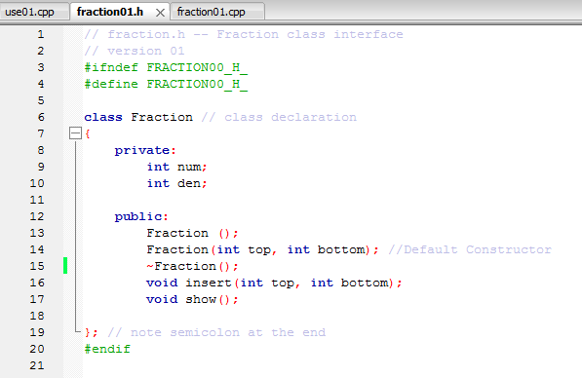

Slide 16
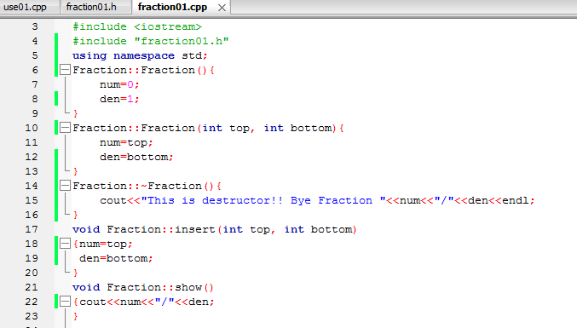

Slide 17
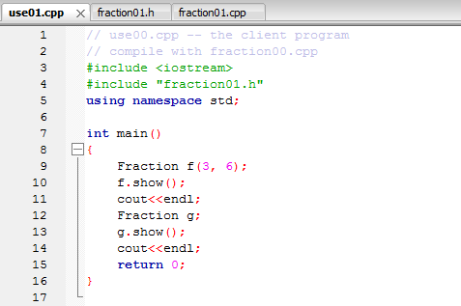

Slide 18
